Slide 1
Constructor, Destructor, Static Keyword, Nested Class
Object-Oriented Programming
3140705
Object-Oriented Programming (01CT0105)
Dr.Chirag Joshi
Department of ICT
chirag.joshi@marwadieducation.edu.in

Slide 2

Looping
What we will learn
Constructors
Accessing objects via reference variable
Using classes from the java library
Static variables, constants and methods
visibility modifiers
Data field encapsulation
Passing objects to methods, array of objects,
Immutable objects and classes,
scope of variable
this reference.

Slide 3

Constructor

Slide 4
Constructor
A constructor in Java is a special type of method that is used to initialize objects.
The constructor is called when an object of a class is created.
A constructor initializes an object immediately upon creation.
It has the same name as the class in which it resides and is syntactically similar to a method.
JVM first allocates the memory for variables (objects) and then executes the constructor to initialize instance variables.
The JVM calls it automatically when we create an object.
A constructor defines what happens when an object of a class is created.
class Cube{
instance variable1
instance variable1
…
Cube()
{
//initailze object }
} //class

Slide 5
Properties of constructor
Constructor is invoked automatically whenever an object of class is created.
Constructors do not have return types and they cannot return values, not even void.
All classes have constructors by default: if you do not create a class constructor yourself, Java creates one for you known as default constructor.
Constructor is a method that is called at runtime during the object creation by using the new operator. The JVM calls it automatically when we create an object.
It is called and executed only once per object.
It means that when an object of a class is created, constructor is called. When we create 2nd object then the constructor is again called during the second time.
class Demo{
instance variable1
instance variable1
…
Demo()
{
//initailze object }
} //class

Slide 6
Types of Constructor
Constructor
Default
No-Argument
Parameterized
Copy Constructor

Slide 7
Default Constructor

Slide 8
Default Constructor: MyConst.java
class MyConst {
public static void main(String[] args) {
MyConst c=new MyConst();
}
}
Compiler
After Compilation
class MyConst{
MyConst(){
//Default Constructor…
}
public static void main(String[] args) {
c=new MyConst();
}
}

Slide 9
Default Constructor
Once you define your own constructor, the default constructor is no longer used.
The default constructor automatically initializes all instance variables to zero.
Example:
class MyAccount{
int accNo;
double balance;
MyAccount(){
//default constructor
}
}//class
class MyBank {
public static void main(String[] args){
MyAccount ma= new MyAccount();
System.out.println("balance="+ma.balance);
}//main()
}//class
Output
balance=0.0

Slide 10
No-Argument Constructor

Slide 11
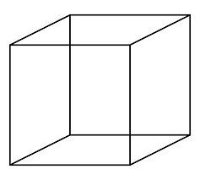
No-Argument Constructor: MyMain.java
class Cube {
double width;
double height;
double depth;
Cube()
{
System.out.println(" Constructing cube");
width = 10;
height = 10;
depth = 10;
}//Cube()
}//class
class MyMain{
public static void main(String[] args){
Cube c=new Cube();
}
}
If you implement any constructor then you no longer receive a default constructor from Java compiler.

Slide 12
Parameterized Constructor

Slide 13
Parameterized Constructor: MyMain.java
class Cube {
double width, height, depth;
Cube(double w, double h, double d)
{ System.out.println(" Constructing cube");
width = w;
height = h;
depth = d;
}//Cube()
}//class
class MyMain{
public static void main(String[] args){
Cube c=new Cube(10,10,10);
}
}

Slide 14

Parameterized Constructor: MyMain.java with method
class Cube {
double width,height,depth;
Cube(double w, double h, double d)
{ System.out.println("Constructing cube");
width = w;
height = h;
depth = d;
}//cube()
void calVolume(){
System.out.println("Volume=" +width*height*depth);
} //calVolume()
} //class
class MyMain{
public static void main(String[] args){
Cube c=new Cube(10,10,10);
c.calVolume();
}
}

Slide 15
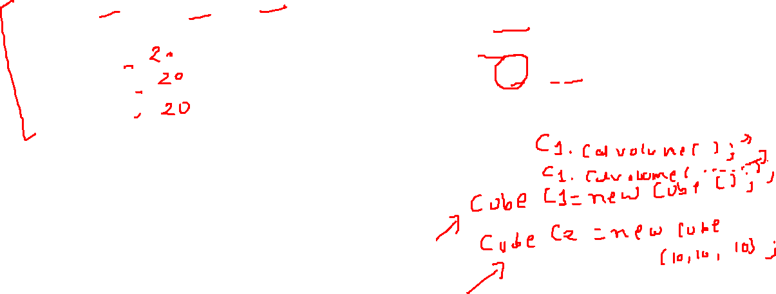
Parameterized Constructor: method with return value
class Cube {
double width,height,depth;
Cube(double w, double h, double d)
{ System.out.println("Constructing cube");
width = w;
height = h;
depth = d;
}//cube()
double calVolume(){
return width*height*depth;
}//calVolume()
}//class
class MyMain{
public static void main(String[] args){
double vol;
Cube c=new Cube(10,10,10);
vol=c.calVolume();
System.out.println(" Volume="+vol);
}
}
Output
Constructing cube
Volume=1000.0

Slide 16

‘this’ keyword
this

Slide 17

class Box {
double length;
double breadth;
double height;
Box(double l, double b, double h) {
System.out.println("Constructing Box");
length = l;
breadth = b;
height = h;
}
void volume() {
double volume = length * breadth * height;
System.out.println("Volume is " + volume);
}
}
class BoxDemo {
public static void main(String args[]) {
Box myBox1 = new Box(10,20,30);
Box myBox2 = new Box(3,6,9);
myBox1.volume();
myBox2.volume();
}
}
Box(double length, double breadth, double height) {
length = length;
breadth = breadth;
height = height;
length is instance variable as well as length is formal parameter of method
Creates ambiguity for compiler
this.length = length;
this.breadth = breadth;
this.height = height;

Slide 18
‘this’ Keyword
this is a reference variable that refers to the current object.
this can be used to invoke current object's method.
this() can be used to invoke current class constructor
this can be passed as a parameter to constructor and method call.
this can be used to return the current object from the method.
This

Slide 19

Copy Constructor

Slide 20
Copy Constructor
It is a special type of constructor that is used to create a new object using the existing object of a class that had been created previously.
It creates a new object by initializing the object with the instance of the same class.
Constructor 1()
{
…
}
Constructor 2(Constructor 1)
{
…
}
Copy Constructor

Slide 21
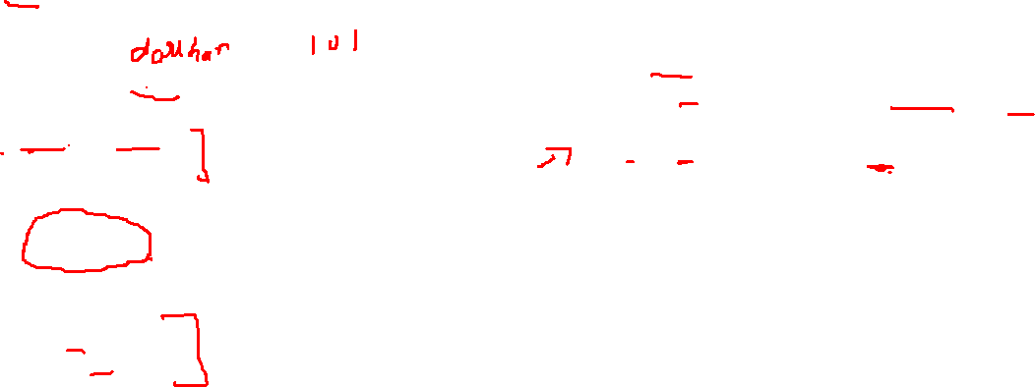
Copy Constructor: MyProgramCopy.java
class Student{
String name;
int rollno;
Student(String s_name, int s_roll){
System.out.println("ConstructorInvoked");
this.name=s_name;
this.rollno=s_roll;
} //Constructor1
Student(Student s){ //CopyConstructor
System.out.println("CopyConstructor Invoked");
this.name=s.name;
this.rollno=s.rollno;
} //Constructor2
public void display(){
System.out.print("name="+name);
System.out.println(" rollno="+rollno);
} // display()
} //class
class MyProgramCopy {
public static void main(String[] args){
float area;
Student s1=new Student("darshan",101);
//invoking Copy Constructor
Student s2=new Student(s1);
s1.display();
s2.display();
} //main()
} //class myProgram
Output
Constructor Invoked
CopyConstructor Invoked
name=darshan rollno=101
name=darshan rollno=101

Slide 22
Advantages of Copy Constructor
It is easier to use when our class contains a complex object with various parameters.
Whenever we need to add all the field of a class to another object, then just send the reference of previously created object.
One of the most importance of copy constructors is that there is no need for any typecasting.
Using a copy constructor, we can have complete control over object creation.
With Copy Constructor, we can pass object of the class as a parameter(pass by reference).
Constructor 1()
{
…
}
Constructor 2(Constructor 1)
{
…
}
Copy Constructor

Slide 23
Constructor Overloading

Slide 24
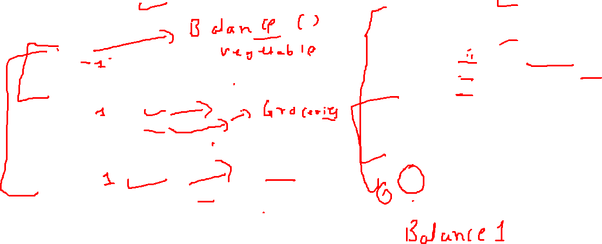
Constructor Overloading
In addition to overloading normal methods, you can also overload constructor methods.
class Balance{
int accNo;
double bal;
Balance(){
System.out.println("inside const1");
bal=0;
}
Balance(double b){
System.out.println("inside const2");
bal=b;
}
Balance(int a,double b){
System.out.println("inside const3");
bal=b;
accNo=a;
}
}
class Account{
public static void main(String args[]){
Balance b1= new Balance();
Balance b2= new Balance(100);
Balance b3=new Balance(1201,10000);
System.out.println("b1.bal="+b1.bal);
System.out.println("b2.bal="+b2.bal);
System.out.println("b3.bal="+b3.bal+ "b3.accNo="+b3.accNo);
}
}

Slide 25

Why Constructor?
The pivotal purpose of constructor is to initialize the instance variable of the class.
We use constructors to initialize the object with the default or initial state.
Through constructor, we can request the user of that class for required dependencies.
A constructor within a class allows constructing the object of the class at runtime.
Allocates appropriate memory to objects.
If we need to execute some code at the time of object creation, we can write them inside the constructor.
Example:
If we talk about a Cube class then class variables are width, height and depth.
But when it comes to creating its object(i.e Cube will now exist in the computer’s memory), then can a cube be there with no value defined for its dimensions? The answer is “NO”.
So constructors are used to assign values to the class variables at the time of object creation.

Slide 26

When to use Constructor?
When we need to execute some code at the time of object creation.
Used for the initialization of instance variables.
To assign the default value to instance variables.
To initializing objects of the class.

Slide 27
Constructor() vs. Method()
 | Constructor() | Method()
Naming | Constructor name must be same as class name. | Method name can be anything.
Return types | Constructor does not have any return type, not even void. | Method must have return types, at least void.
Call | Constructor can be invoked implicitly when object is created. | Method is called by the programmer. Invoked explicitly.
Purpose | To initialize an object | To execute the code
Inheritance | Constructor cannot be inherited by subclass. | Method can be inherited by subclass.

Slide 28
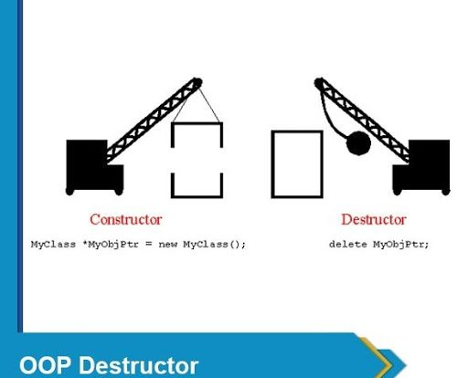
Destructor

Slide 29

Destructor
Destructor is the opposite to the constructor. Constructor is used to initialize objects while the destructor is used to delete or destroy the object that releases the resource occupied by the object.
Definition: Destructor is an instance member function which is invoked automatically whenever an object is going to be destroyed.
In other words, a destructor is the last function that is going to be called before an object is destroyed.
In java, there is a special method named garbage collector that automatically called when an object is no longer used.
When an object completes its life-cycle the garbage collector deletes that object and de-allocates or releases the memory occupied by the object.
In C++, dynamically allocated objects must be manually released by use of a delete operator.
Java takes a different approach: it handles de-allocation automatically.
The technique that accomplishes this is known as “garbage collection”.

Slide 30
Destructor
Why Destructor?
When we create an object of the class(using new), it occupies some space in the memory. If we do not delete these objects, it remains in the memory and occupies unnecessary space.
To resolve this problem, we use the destructor.
Remember that there is no concept of destructor in Java.
Instead of destructor, Java provides the garbage collector that works the same as the destructor.
The garbage collector is a program (thread) that runs on the JVM. It automatically deletes the unused objects (objects that are no longer used) and free-up the memory.
The programmer has no need to manage memory, manually.

Slide 31
Working of garbage collector(destructor) in java
When the object is created it occupies the space in the heap. These objects are used by the threads.
If the objects are no longer used by the thread it becomes eligible for the garbage collection.
The memory occupied by that object is now available for new objects that are being created.
When the garbage collector destroys an object, the JRE calls finalize() method to close the connections such as database and network connection.

Slide 32
Static

Slide 33
Static in java
Static in Java
Static Variable
Static Method
Static Block
Static Class

Slide 34
Static
The static keyword is used for memory management.
We can apply static keyword with variables, methods, blocks and nested classes.
The static keyword belongs to the class than an instance of the class.
The static can be:
Variable (also known as a class variable)
Method (also known as a class method)
Block
Nested class

Slide 35
Static Variable
Static variables have a property of preserving their value even after they are out of their scope.
The static variable gets memory only once in the class area at the time of class loading.
Advantage of static variable: It makes program memory efficient (static variable saves memory).
Characteristics of static variable:
It is initialized to zero when the first object of its class is created. No other initialization is allowed.
Only one copy of that member is created for the entire class and is shared by all the objects of that class, no matter how many objects are created.
It is visible only within the class, but its lifetime is the entire program.
Static variables are normally used to maintain values common for all objects.
The class constructor does not initialize static variable.

Slide 36
Static vs Non-Static Function
MyProgram.java(Non-static function)
MyProgram.java(static function)
public class MyProgram { public static void main(String[] args) { int a=1,b=2,c; MyProgram mp=new MyProgram(); c = mp.add(a,b); System.out.println(c); }//main public int add(int i,int j) { return i + j; } }//class
public class MyProgram { public static void main(String[] args) { int a=1,b=2,c; c = add(a,b); System.out.println(c); }//main static int add(int i,int j) { return i + j; } }//class

Slide 37
Characteristic of static method
A static method can call only other static methods and can not call a non-static method from it.
A static method can be accessed directly by the class name and doesn’t need any object
A static method cannot refer to “this” or “super” keywords in anyway

Slide 38
Static Method: WAP using class Rectangle and calculate area
import java.util.*;
class Rectangle{
static float height;
static float width;
static void calArea() {
System.out.println( "Area= " +height*width);
} //calArea()
} //class
class MyRectangle {
public static void main(String[] args){
Rectangle r1= new Rectangle();
Scanner sc= new Scanner(System.in);
System.out.print("enter height:");
r1.height=sc.nextFloat();
System.out.print("enter width:");
r1.width=sc.nextFloat();
Rectangle.calArea();
} //main()
} //class
Output
enter height:30.55
enter width:20.44
Area=624.442

Slide 39
static keyword
static keyword is mainly used for memory management.
It can be used with
Variables
Methods
Blocks
Nested classes
Basically, static is used for a constant variable or a method that is same for every instance of a class.
The static variable can be used to refer to the common property of all objects.
The static variable gets memory only once in the class area at the time of class loading.
It makes your program memory efficient.
Syntax
static type variablename;

Slide 40
class Student {
int rollNo;
String name;
.
.
.
}
static String college = "DIET";
String college = "DIET";
class StudentDemo {
public static void main(String args[]) {
Student student1 = new Student();
Student student2 = new Student();
Student student3 = new Student();
.
.
.
}
}
student1
student2
student3
rollNo
name
college
DIET
DIET
DIET
college
DIET

Slide 41
static method
If you apply static keyword with any method, it is known as static method.
A static method belongs to the class rather than the object of a class.
A static method can be invoked without the need for creating an instance of a class.
A static method can access static data member and can change the value of it.
Restrictions
The static method can not use non static data member or call non-static method directly.
this and super cannot be used in static context.

Slide 42
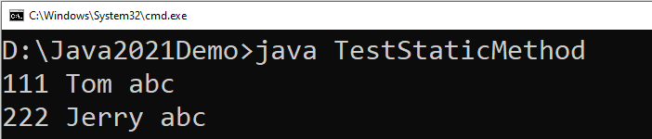
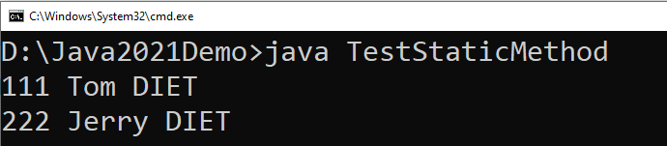
class Student {
int rollno;
String name;
static String college="abc";
static void change() {
college = "DIET";
rollno = 10;
}
Student(int r, String n) {
rollno = r;
name = n;
}
void display() {
System.out.println(rollno+" "+name+" "+college);
}
}
class TestStaticMethod {
public static void main(String args[]) {
Student.change();
Student s1 = new Student(111,"Tom");
Student s2 = new Student(222,"Jerry");
s1.display();
s2.display();
}
}
We can not use non-static variables in static methods

Slide 43
Static Block
Static block is executed exactly once, when the class is first loaded.
It is used to initialize static variables of the class.
It will be executed even before the main() method.
Syntax
How to call static block in java?
Unlike method, there is no specified way to call a static block.
The static block executes automatically when the class is loaded in memory.
static {
//initialisation of static variables…
}

Slide 44
Example: Static Block, Method and Variable
class StaticDemo {
static int a = 4; //static variable declared & initialized
static int b; //static variable declared
static void dispValue(int x) {
System.out.println("Static method initialized.");
System.out.println("x = " + x);
System.out.println("a = " + a);
System.out.println("b = " + b);
} //static method
static {
System.out.println("Static block initialized.");
b= a * 5;
} //static block
public static void main(String args[]) {
System.out.println("inside main()...");
dispValue(44);
} //main()
} //class
3
1
Output
Static block initialized.
inside main()...
Static method initialized.
x = 44
a = 4
b = 20
2

Slide 45
Points to remember for static keyword
When we declare a field static, exactly a single copy of that field is created and shared among all instances of that class.
Static variables belong to a class, we can access them directly using class name. Thus, we don't need any object reference.
We can only declare static variables at the class level.
We can access static fields without object initialization.
Static methods can't be overridden.
Abstract methods can't be static.
Static methods can't use this or super keywords.
Static methods can't access instance variables and instance methods directly. They need some object reference to do so.
A class can have multiple static blocks.

Slide 46
Mutable and Immutable Objects
The content of mutable object can be changed, while content of immutable objects can not be changed.
class MutableClass{
int a;
void add5() {
a = a + 5;
}
}
public class MutableClassDemo {
public static void main(String[] args) {
MutableClass m1 = new MutableClass();
m1.a = 10;
m1.add5();
System.out.println(m1.a);
}
}
class ImmutableClass{
int a;
int add5() {
return ( a + 5 );
}
}
public class MutableClassDemo {
public static void main(String[] args) {
ImmutableClass m1 = new ImmutableClass();
m1.a = 10;
int ans = m1.add5();
System.out.println("A in m1 = " + m1.a);
System.out.println("returned = " + ans);
}
}

Slide 47
Passing Objects as Argument
In order to understand how and why we need to pass object as an argument in methods, lets see the below example.
class Time{
int hour;
int minute;
int second;
public Time(int hour, int minute, int second) {
this.second = second;
this.minute = minute;
this.hour = hour;
}
void add(Time t) {
this.second += t.second;
if(this.second>=60) {
this.minute++;
this.second-=60;
}
this.minute += t.minute;
if(this.minute>=60) {
this.hour++;
this.minute-=60;
}
this.hour += t.hour;
}
}
public class TimeDemo {
public static void main(String[] args) {
Time t1 = new Time(11,59,55);
Time t2 = new Time(0,0,5);
t1.add(t2);
System.out.println(t1.hour + ":" + t1.minute + ":" + t1.second);
}
}

Slide 48
Array of Objects
We can create an array of object in java.
Similar to primitive data type array we can also create and use arrays of derived data types (class).
class Student{
int rollNo;
String name;
public Student(int rollNo, String name) {
this.rollNo = rollNo;
this.name = name;
}
void printStudentDetail() {
System.out.println("| "+
rollNo
+" | -- | "+
name +" |");
}
}
public class ArrayOfObjectDemo {
public static void main(String[] args) {
Student[] stu = new Student[3];
stu[0] = new Student(101,"darshan");
stu[1] = new Student(102, "OOP");
stu[2] = new Student(103,"java");
stu[0].printStudentDetail();
stu[1].printStudentDetail();
stu[2].printStudentDetail();
}
}

Slide 49
Nested Class

Slide 50
Nested Class
Nested Class: Class within another class
Scope: Nested class is bounded by the scope of its enclosing class.
E.g. class B is defined within class A, then B is known to A, but not outside of A.
A nested class has access to the members, including private members of the class in which it is nested.
However, the enclosing class does not have access to the members of the nested class. i.e. Class B can access private member of class A, while reverse is not accessible.
A: Outer Class
B: Nested
Class

Slide 51
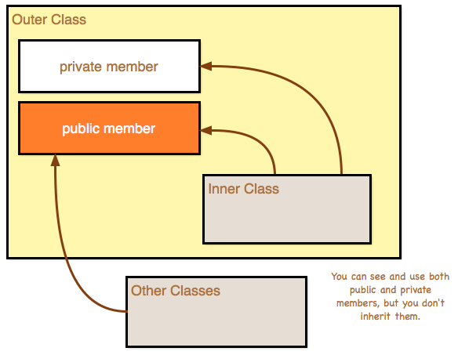
Nested Class

Slide 52
Nested Class
Types of Nested class:
Nested Class
Static
Nested Class
Non- Static
Nested Class

Slide 53
Non-Static Nested Class: InnerOuterDemo.java
class Outer{
private int a=100;//instance variable
void outerMeth(){
Inner i= new Inner();
System.out.println("inside outerMeth()...");
i.innerMeth();
}
class Inner{
int b=20;
void innerMeth(){
System.out.println("inside innerMeth()..."
+(a+b));
}
} //inner class
} //outer class
class InnerOuterDemo{
public static void main(String[] args)
{
Outer o= new Outer();
o.outerMeth();
}
} //InnerOuterDemo
Output
inside outerMeth()...
inside innerMeth()...120

Slide 54
Static Nested Class: InnerOuterDemo
class Outer{
void outerMeth(){
Inner i= new Inner();
System.out.println("inside outerMeth()...");
i.innerMeth();
}
static class Inner{
int b=20;
void innerMeth(){
System.out.println("inside innerMeth()..."
+(a+b));
}
} //inner class
} //outer class
error: non-static variable a cannot be referenced from a static context
static int a=100;
class InnerOuterDemo{
public static void main(String[] args)
{
Outer o= new Outer();
o.outerMeth();
}
} //InnerOuterDemo
int a=100;//instance variable
Output
inside outerMeth()...
inside innerMeth()...120

Slide 55
Points to remember: Inner class
Inner class implements a security mechanism in Java.
Reduces encapsulation, more organized code by logically grouping the classes.
A: Outer Class
B: Nested
Class

Slide 56
Package (Not part of this Unit)
A Package can be defined as a grouping of related types providing access protection and name space management.
Programmers can define their own packages to bundle group of classes/interfaces, etc.
Packages are used in Java in order to
prevent naming conflicts
control access,
make searching/locating of classes/interfaces easier.
It is a good practice to group related classes implemented so that a programmer can easily determine that the classes, interfaces are related.

Slide 57
Creating a package
To create a package you need to write package statement followed by the name of the package.
Syntax : package package_name;
Example :
The package statement should be the first line in the source file.
There can be only one package statement in each source file, and it applies to all types in the file.
If a package statement is not used then the class/interfaces will be put into an unnamed package.
package darshan_student;
class Student {
// code
}

Slide 58
Package (Example)
To compile
javac –d . Animal.java
To Run the class file
java myPackage.Animal
package myPackage;
public class Animal {
public String name;
public void eat(){
System.out.println("Organic Food !!!!");
}
public static void main(String[] args){
Animal a = new Animal();
a.eat();
}
}
.
Represent the current directory

Slide 59
import keyword
import keyword is used to import built-in and user-defined packages into your java source file so that your class can refer to a class that is in another package by directly using its name.
There are 3 different ways to refer to class/interface that is present in different package
import the class/interface you want to use.
import all the classes/interfaces from the package.
Using fully qualified name.
We can import a class/interface of other package using a import keyword at the first line of code.
Example :
import java.util.Scanner;
public class DemoImport {
public static void main(String[] args)
{
Scanner s = new Scanner(System.in);
// Code
}
}

Slide 60
import (importing all class/interface)
We can import all the classes/interfaces of other package using a import keyword at the first line of code with the wildcard (*).
Example :
It is possible to use classes from other packages without importing the class using fully qualified name of the class.
Example :
import java.util.*;
public class DemoImport {
public static void main(String[] args)
{
Scanner s = new Scanner(System.in);
Date d = new Date();
// Code
}
}
java.util.Scanner s = new java.util.Scanner(System.in);

Slide 61
Static Import
The static import feature of Java 5 facilitate the java programmer to access any static member of a class directly.
Advantage : Less coding is required if you have to access any static member of a class more frequently.
Disadvantage : If you overuse the static import feature, it makes the program unreadable and unmaintainable.
import static java.lang.System.out;
public class S2{
public static void main(String args[]){
out.println("Hello main");
}
}
We need not to write System.out as we have imported the out statically

Slide 62
Access Control
Modifier | Same Class | Same Package Sub Class | Same Package Non Sub Class | Different Package Sub Class | Different Package Non Sub Class
Private
Default
Protected
Public

Slide 63
Programs
Write a class named Rectangle to represent a rectangle. It contains following members: Data: width (double) and height (double) that specify the width and height of the rectangle. Methods: 1. A no-arg constructor that creates a default rectangle. 2. A constructor that creates a rectangle with the specified width and height. 3. A method named getArea() that returns the area of this rectangle. 4. A method named getPerimeter() that returns the perimeter.
Write a program to create circle class with area function to find area of circle.
Define time class with hour and minute. Also define addition method to add two time objects.
Declare a class called student having following data members:id_no, no_of_subjects_registered, subject_code, subject_credits, grade_obtained and spi. Define constructor and calculate_spi methods. Define main to instantiate an array for objects of class student to process data of n students.

Slide 64
Thank You

